Slide 1
my room using adjectives
By Tulika

Slide 2
What is a bedroom ?
A bedroom is a place where anyone feels comfortable . The bedroom is your own personal space .

Slide 3
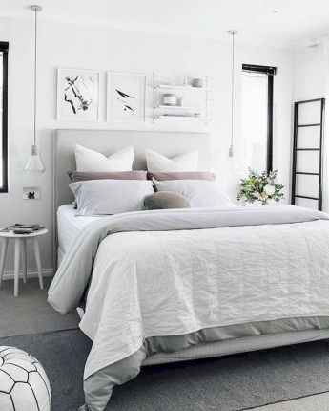
My room
My room is very beautiful. My room is white in colour.

Slide 4
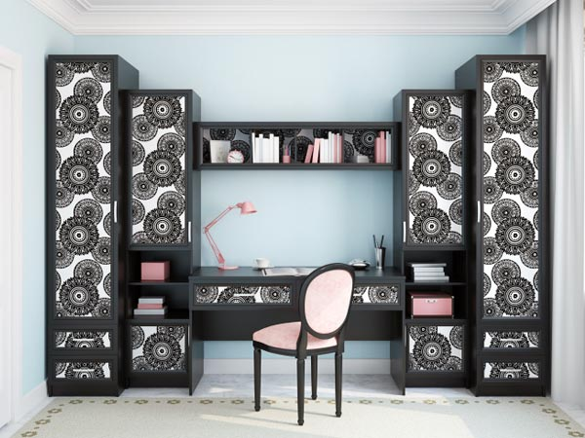
My room
What I love about my room is the study table . My study table consist of a comfortable chair and a big space for studying .

Slide 5
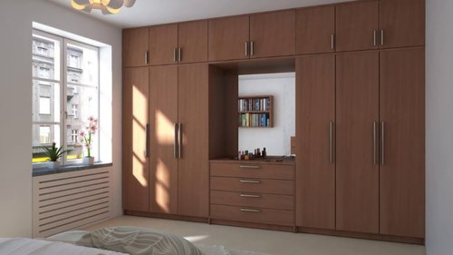
My room
In my room I have two wardrobes , one for clothes and another for books .

Slide 6
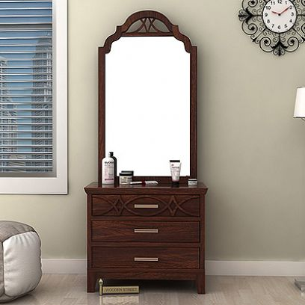
My room
The most important part of my room is dressing table. At which I look most often and admire myself .

Slide 7
a room should never allow the eye to settle in one place . It should smile at you and create fantasy .
By – Juan Montoya

